Slide 1

Presents
SMALL BUSINESS CREDIT SURVIVAL BOOT CAMP®
January 27, 2026 | Springfield, VA
SPONSOR GUIDE

Slide 2
Who is For small business only?
For Small Business Only, LLC (FSBO) is a participant-based, business credit education production company focused on providing qualified small business owners with practical, useful applications and knowledge to build and secure TRUE business credit.
Since 2013, we have help thousands of small business owners successfully establish and build viable and sustainable business credit for their companies.

Slide 3
What is the Small Business Credit Survival Boot Camp®?
The Small Business Credit Survival Boot Camp© property is a unique, one-day event developed to sync qualified small business owners with specific lenders and corporate creditors, who want to fulfill their community reinvestment obligations by assisting small business owners in starting their journey to establishing and building, viable and sustainable business credit.
At the Boot Camp, we invite specific lenders and corporate creditors, who want to fulfill their community reinvestment obligations to connect with decision makers, and assist them on their credit building journey.

Slide 4
connect with decision makers who are qualified and actively seeking to build their business credit profiles for their businesses!

Slide 5
SPONSORSHIP PHILOSOPHY
The Small Business Credit Survival Boot Camp offers a variety of participant engagement opportunities for sponsors including 31+ data points lead generation on each small businesses/owners, corporate branding, speaking, and networking.
We work with our sponsors to identify best uses of boot camp assets to achieve maximum exposure to increase existing sales and marketing efforts to decision-makers.
We use in-person activations, product integrations, contests, onsite and podcast interviews, and prominent logo placement to promote our sponsors. Our sponsors can educate on the importance of strong credit profiles for lending, entertain and engage a focused and qualified audience of decisions-makers focused on building and growing their business credit.

Slide 6
About Our qualified attendees
The Small Business Credit Survival Boot Camp attracts business owners whose businesses must qualify to attend the boot camp.
Our attendees are primary decision makers who are eager to engage with boot camp sponsors. With a focus on building and increasing viable and sustainable business credit for their companies, our attendees are extremely interested in the products and services provided by the sponsors.
Each qualified business owner can utilize several products and services of each sponsors with future opportunity to increase their product usage. All of our attendees expect sponsor participation.

Slide 7
Our audience at a glance
100% are final decision makers
100% have the title of President/CEO/Owner
100 % want to improve or expand their business credit
89% will apply for lines of credit/request increase lines of credit
99% expects to grow, expand, and secure working capital
89% would consider using a sponsor’s product
80% will apply for new credit cards/request new limits on credit cards
79% of confident in their businesses future
62% expects to purchase assets and upgrade technology

Slide 8
In the next 18 months…
Our Attendees plan to;
  80% - Secure a business credit card/store cards
  78% - Secure business loans
  89% - Secure lines of credit/request increase on existing lines
  41% - Willing to change banks for better relationships
  22% - Purchase company vehicle
  11% - Refinance/purchase real estate
  61% - Use equipment leasing
  41% - Purchase business insurance
  38% - Seek legal business advice
  29% - Seek investment advice
  69% - Purchase business apparel
  55% - Upgrade business mobile devices/plans

Slide 9
Our attendees are responsive
45.8% open rate on emails with a click rate of 11.4%
79% would change a purchase based on sponsorship
Not only do our attendees want to experience the boot camp, they want to know who we are working with (companies just like yours)!

Slide 10

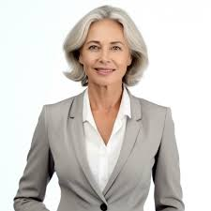
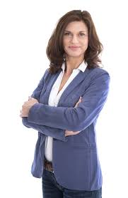
Let me introduce you to…
John
Brooke
Gina

Slide 11
Meet john, the entrepreneur
John is 35, single, and lives in Washington, DC with an annual household income of $138.8K. He started his company in retail sales.
John’s company had an annual revenue of $521,000 in 2024.
John wants to increase his business credit and expand his company. He wants to engage eager with corporate creditors.
John is interested in this property because he wants to receive business credit, learn about credit building, and receive financial literacy training.
John is concerned about building business credit to minimize cash flow usage.
As relatively new business owners, John values financial education and understanding access to the right tools and networks.

Slide 12
Meet Brooke, the High Net-worth Earner
Brooke is 41, married with two young children, and lives in Chantilly, Virginia with an annual household income of $408K. She started her company in medical equipment sales.
Brooke’s company had an annual revenue of $2.46M in 2024
Brooke wants to increase her business credit and improve her cashflow. She is eager to network with other high net worth earners.
Brooke is interested in this property because she wants build business credit, increase her cash flow, and network with other business owners.
Brooke is concerned about sustaining her cash flow and increasing her working capital.
Brooke values financial freedom and utilizing the right credit tools to expand her business.

Slide 13
Meet Mia, the second stager
Gina is 54, married with three teenager, and lives in Bowie, Maryland with an annual household income of $243K. She retired early and started her company in workforce planning.
Gina’s company had an annual revenue of $963K in 2024.
Gina wants to learn about business credit for her new company after retiring early. She is eager to increase her business financial knowledge.
Gina is interested in this property because she wants build business credit, increase her cash flow, and network with other business owners.
Gina is concerned about securing capital for growth and expansion.
Gina values hardworking and learning as much as she can about the financial education in credit building.

Slide 14

Digital and media presence

Slide 15
Digital presence
Social media followers are combined of 21,000+
Database size of 54,000+ with focus on Goldman Sachs 10,000 Small Businesses and Business Accelerator throughout U.S.
Web traffic stats 11859
Roku Ad Manager Commercial Campaign stats of 164,900 impressions

Slide 16
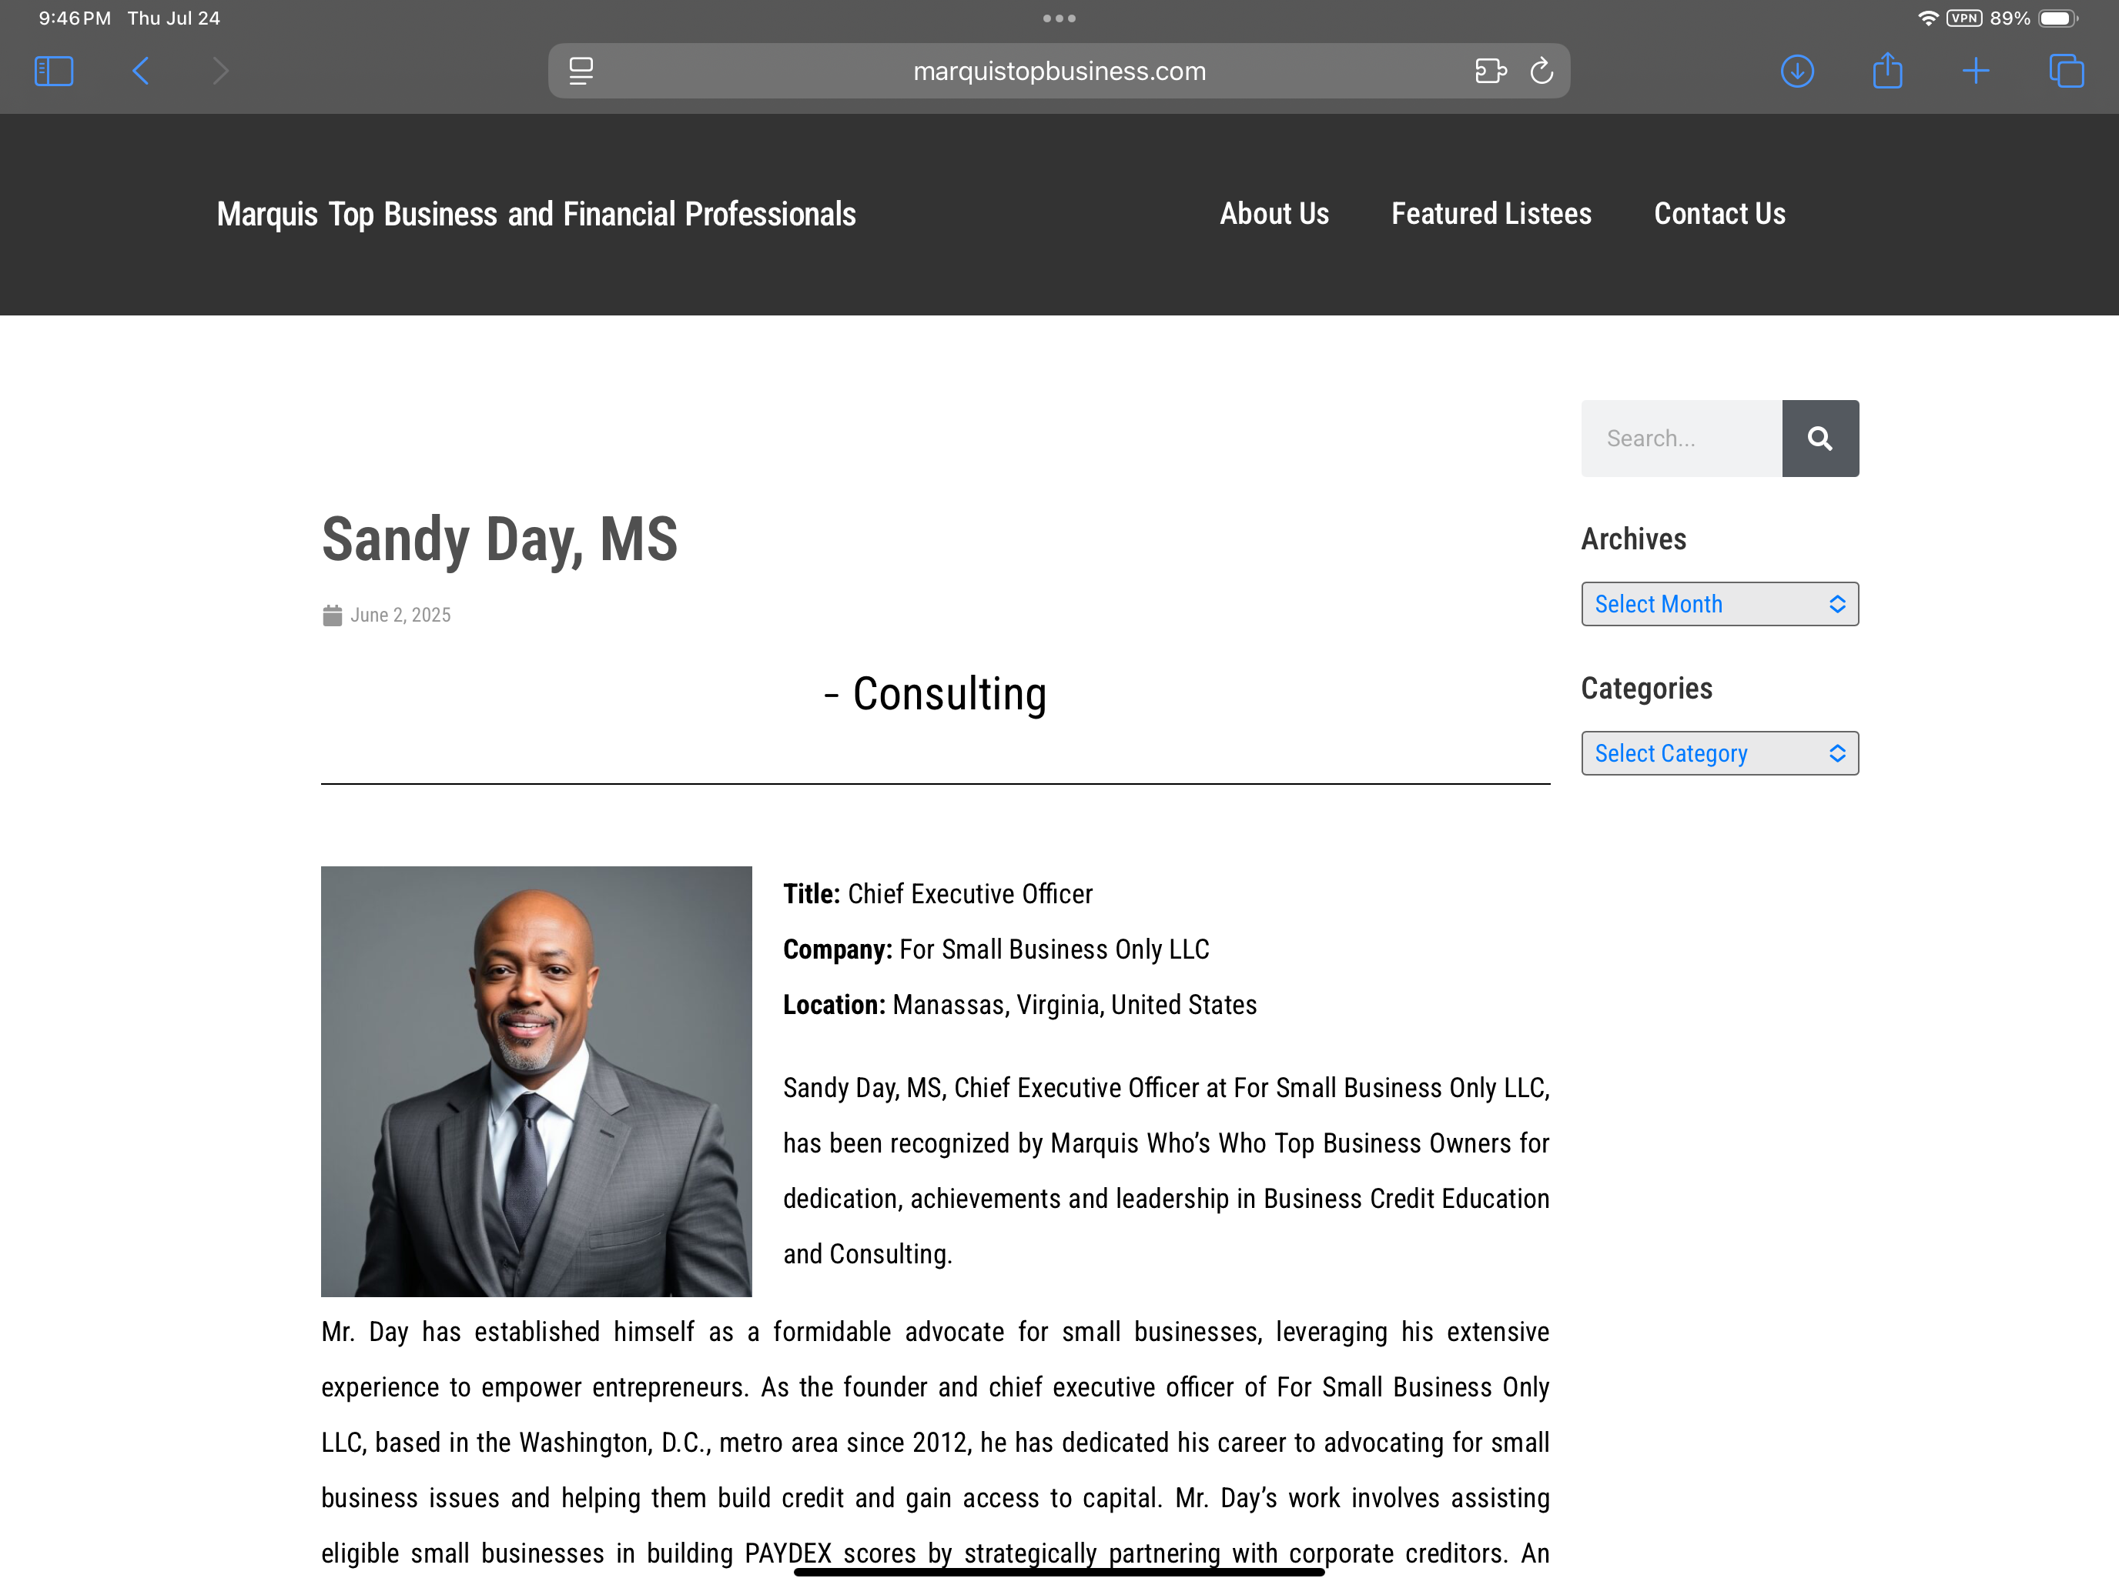
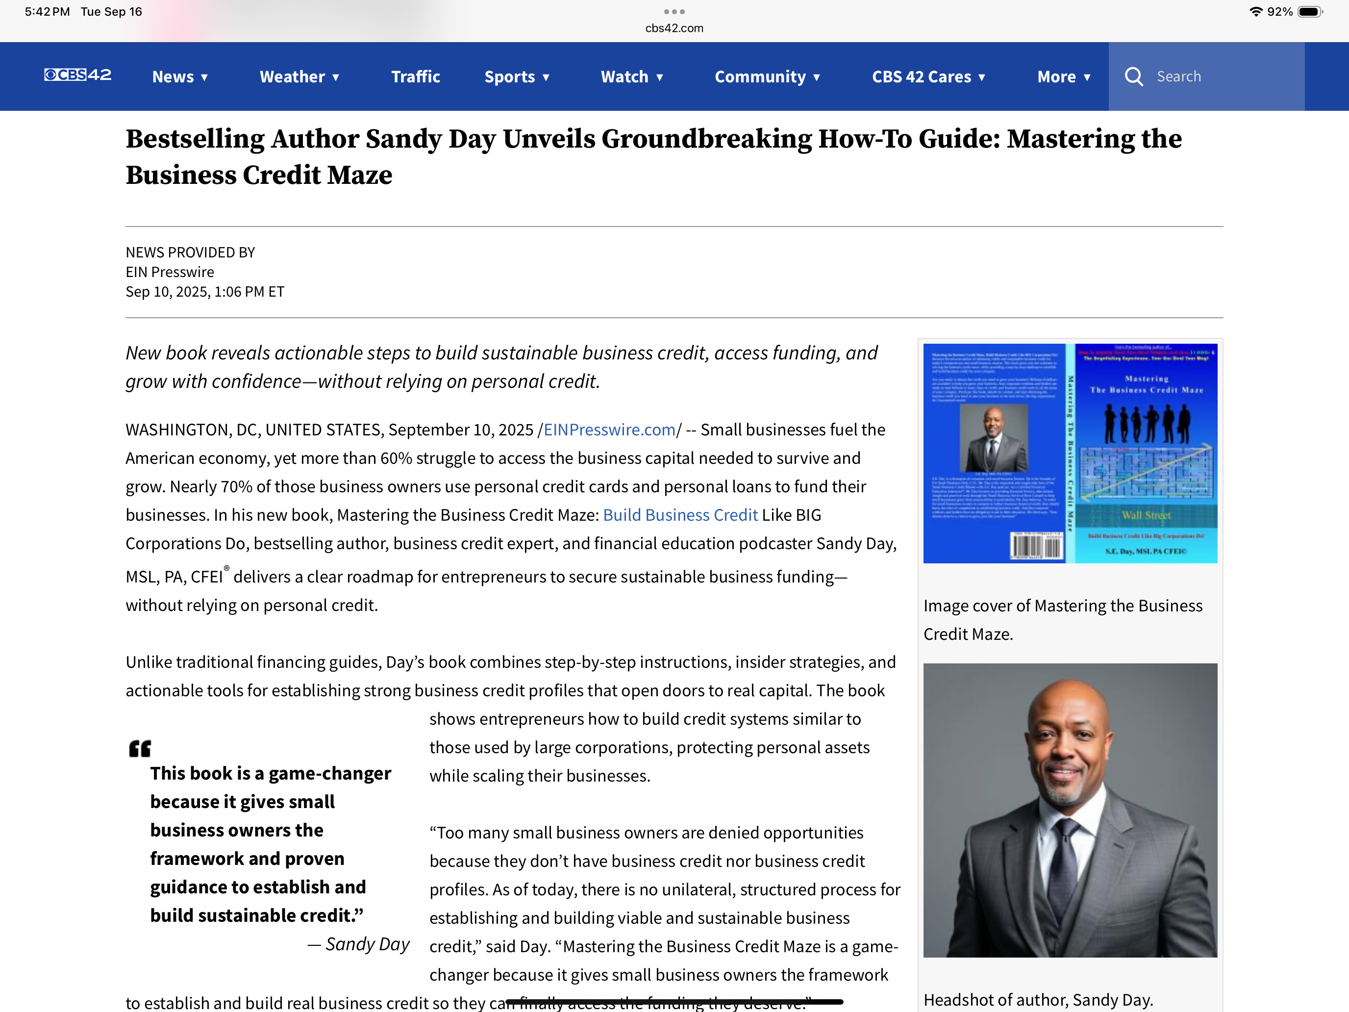
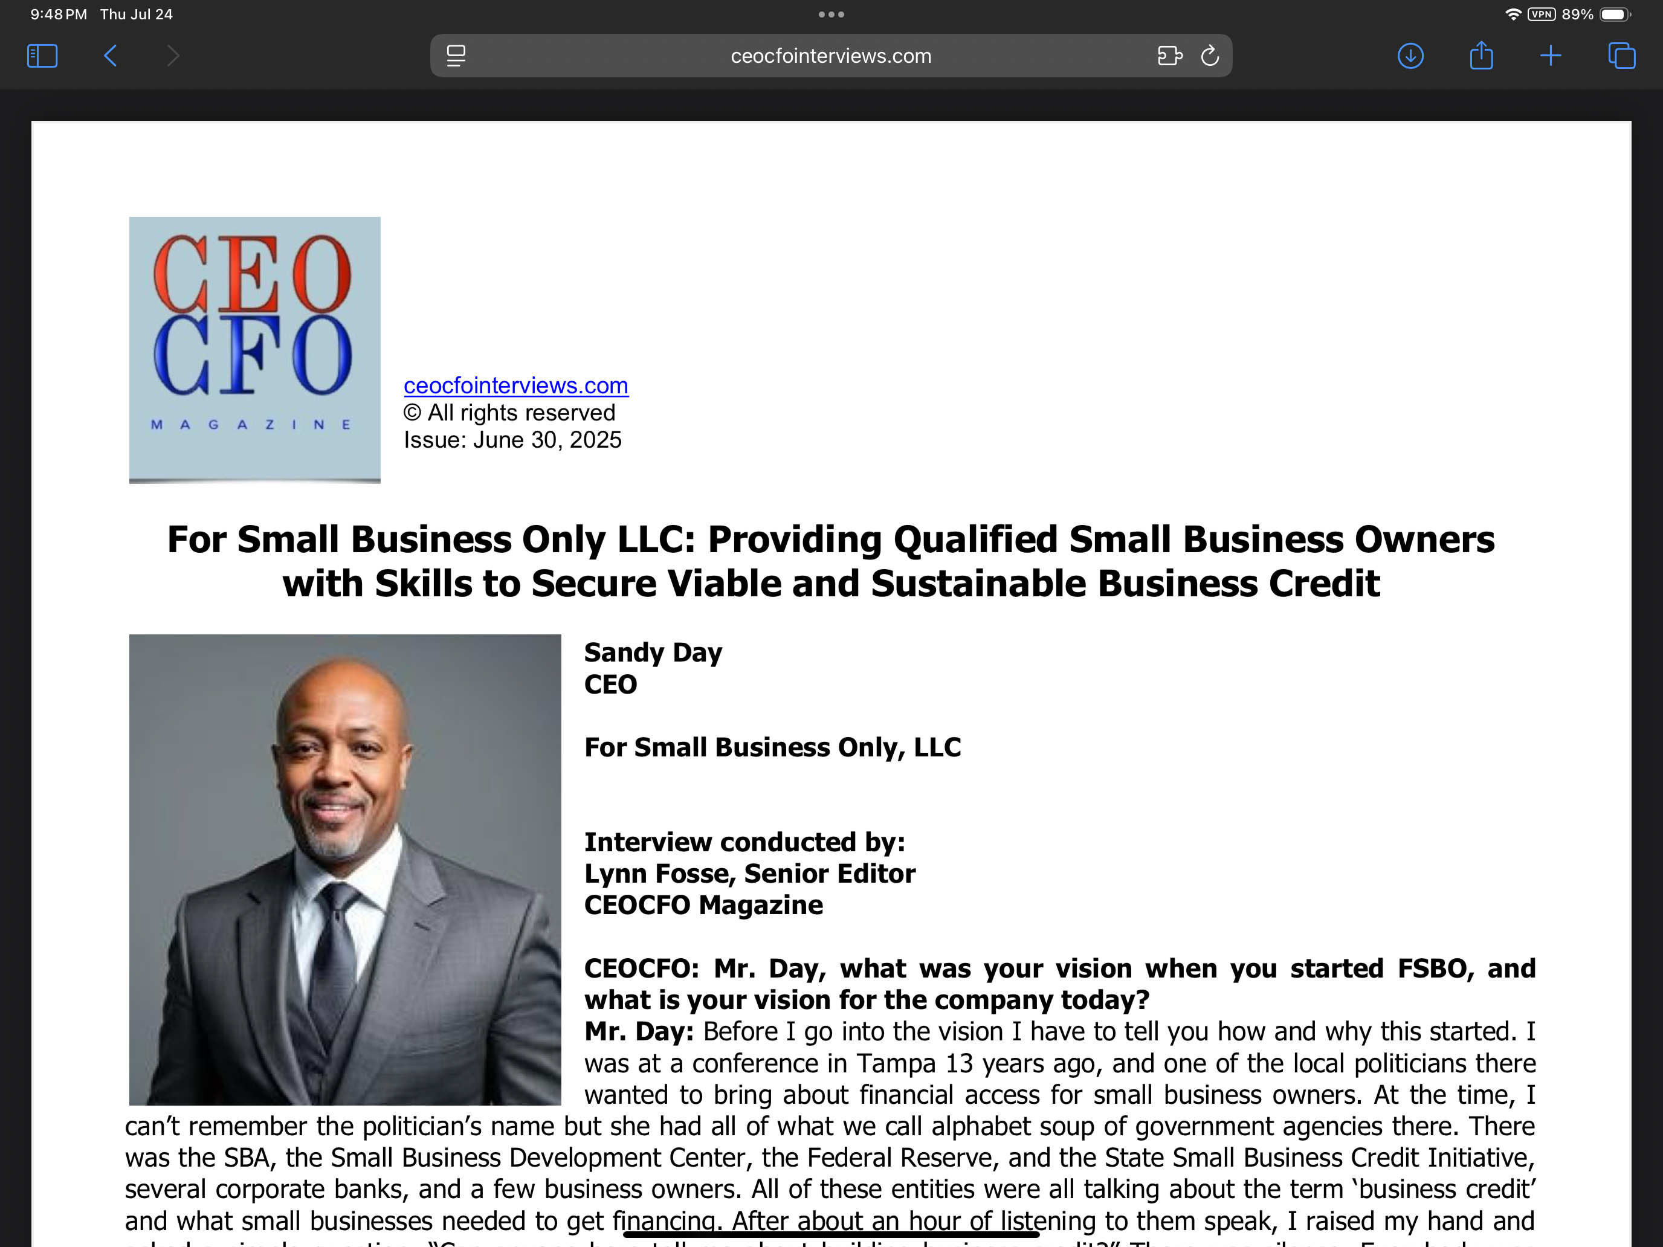
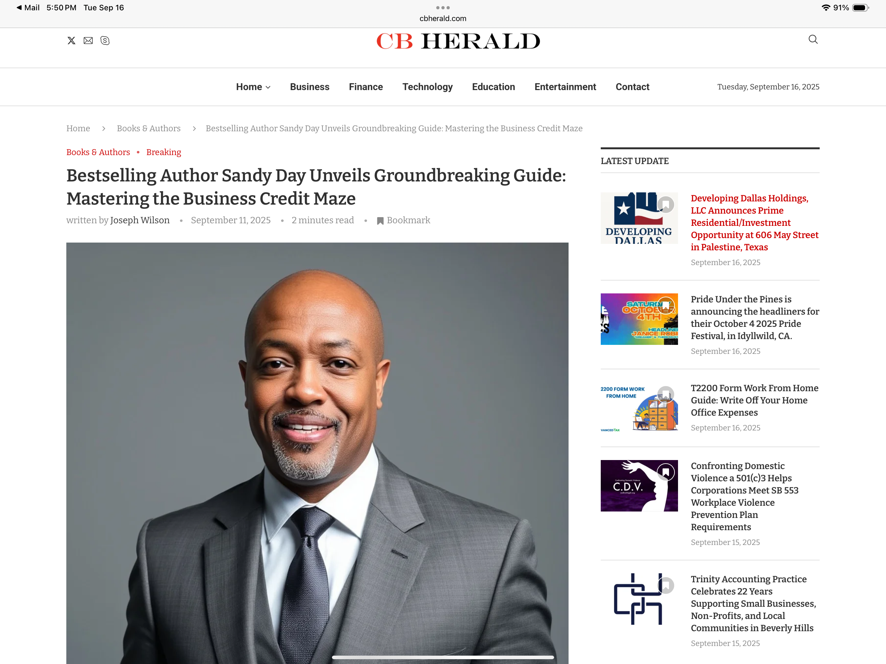
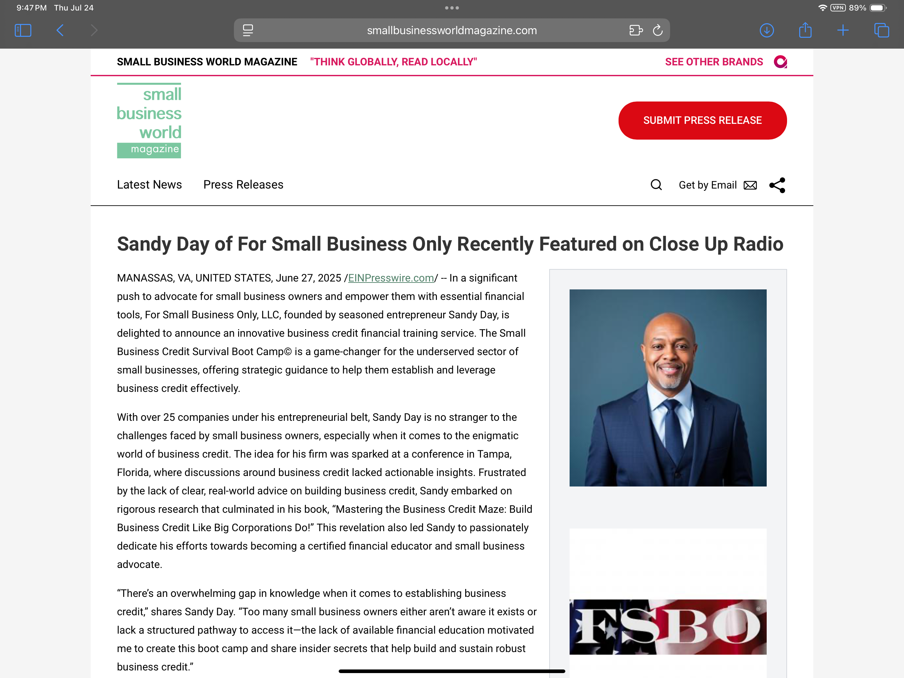
Organic media
Where you appear
  Marquis Who’s Who Top Business Spotlight w/ S.E. Day of FSBO
  Close Up Talk Radio Interview w/ S.E. Day of FSBO
  CEOCFO Magazine Interview w/ S.E. Day of FSBO
  Bestselling Author Sandy Day Unveils Groundbreaking How-To Guide

Slide 17
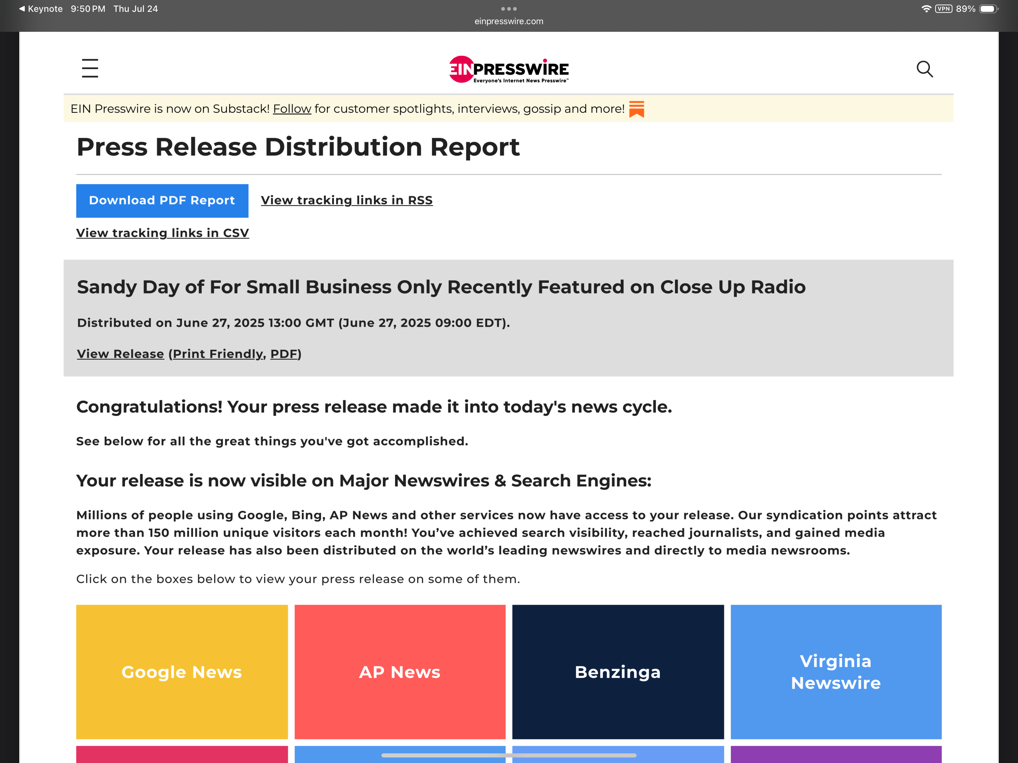
Media partnerships
Nationally, we partner with Close Up Television.
  Total organic media traffic and viewership is 150 Million, comprised of businesses, industry professionals, and the general public.
  Distribution Report

Slide 18
Everything promotion is customizable
We don’t use Gold, Silver, Bronze packages. We build our activations around your desired outcome.
We want to learn about your goals, how you measure ROI and what you are trying to achieve.
Once we know that, then we can offer you participation tailored to your needs.

Slide 19
We can work together to achieve your goals
Activation Opportunities
Presentation/Speaking
‘Ask Me Anything’ session
:30 “Featured Business” Commercial Contest w/ Sponsor
On-site ‘Business Credit Achievement’ Interview Station
Mastering the Business Credit Maze Book Gift Away presented by sponsor
Partner Brand Recognition
Naming Opportunities
Social Media/Email
Media Recognition
Podcast Interviews
:30 Commercial Contest
Book Gift Away

Slide 20
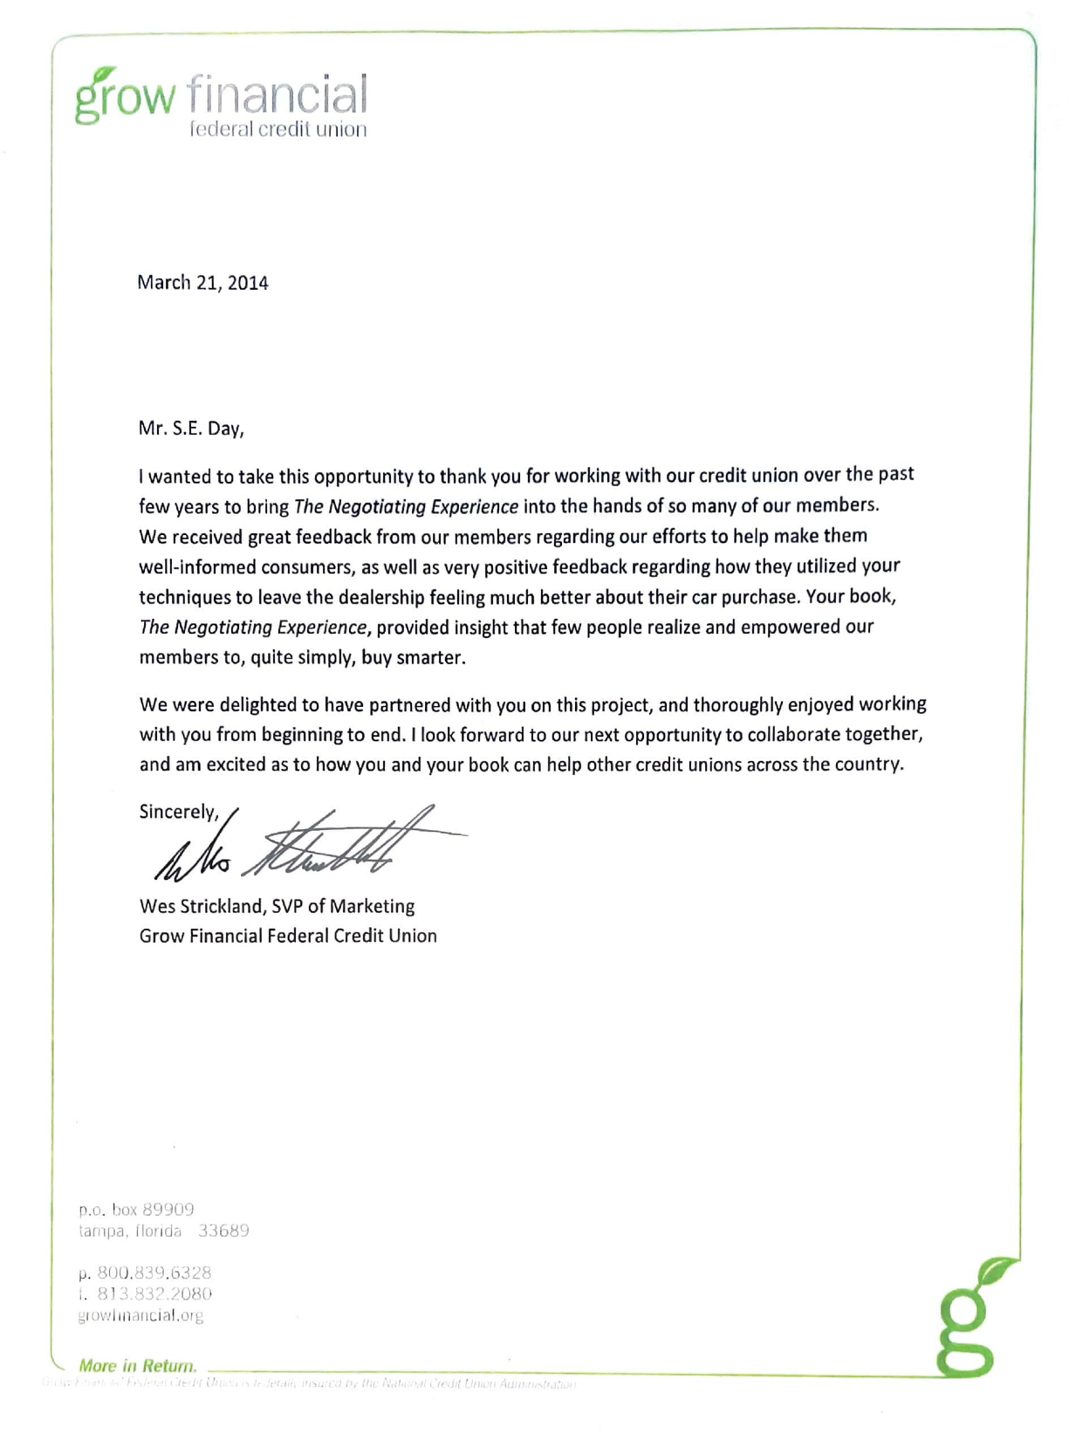
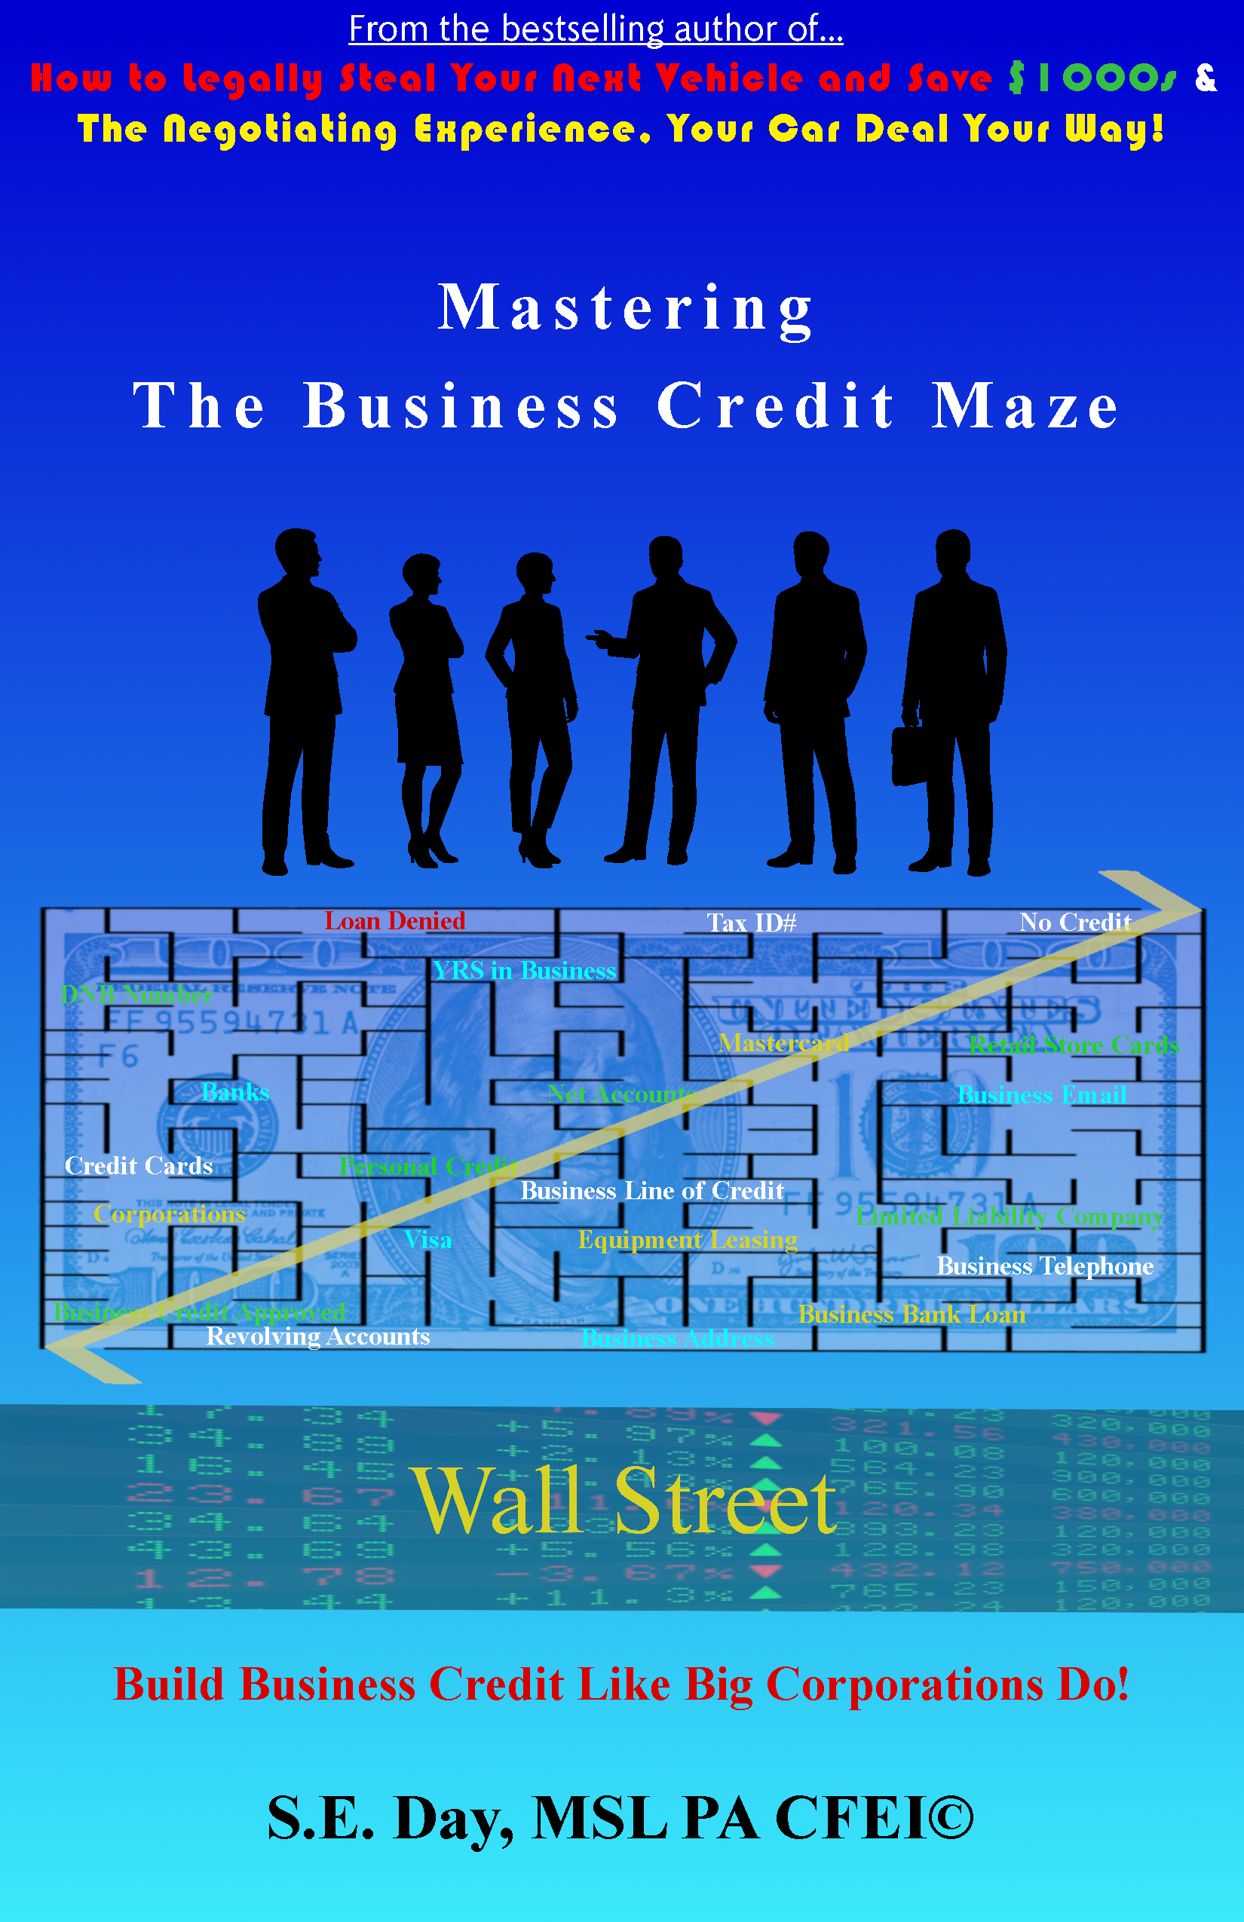

property activations - Book gift away
The Book Gift Away is a unique activation which connects sponsors directly to their target audience.
Connect with Attendees eager to learn the ‘How To’ roadmap to building business credit.
The attendees receive Mastering the Business Credit Maze, Build Business Credit Like BIG Corporations Do! as a special gift from the sponsor with the sponsor’s name co-branded on the book.
Allows sponsors to build brand trust, loyalty, and awareness! Generate leads!

Slide 21
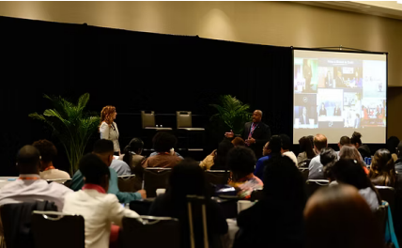
property activations - ask me anything
The Ask Me Anything (AMA) Session is a 20-minute, interactive fireside chat where a sponsor representative engages directly with attendees of the Boot Camp. This live, unscripted session provides the sponsor with a platform to share their expertise, showcase their products or services, and answer real-time questions from participants.
Sponsors are positioned as trusted advisors and thought leaders, offering actionable insights and practical solutions that align with the challenges small business owners face.
Attendees will enjoy an intimate, conversational experience that feels personal and engaging — not like a sales pitch. During the AMA, the audience can:
Ask Real Questions
Gain Insider Access
Walk Away With Value
This experience positions the sponsor as a helpful partner rather than just a vendor — deepening trust and increasing the likelihood of post-event engagement.
Sponsors receive integrated visibility before, during, and after the AMA session:
Pre-Event Branding
Live Event Branding
Digital Engagement
Post-Event Follow-Up
Sponsors can measure the activation’s ROI using both qualitative and quantitative metrics:
Engagement Metrics
Reach & Visibility
Lead Generation
Brand Sentiment
Conversions

Slide 22
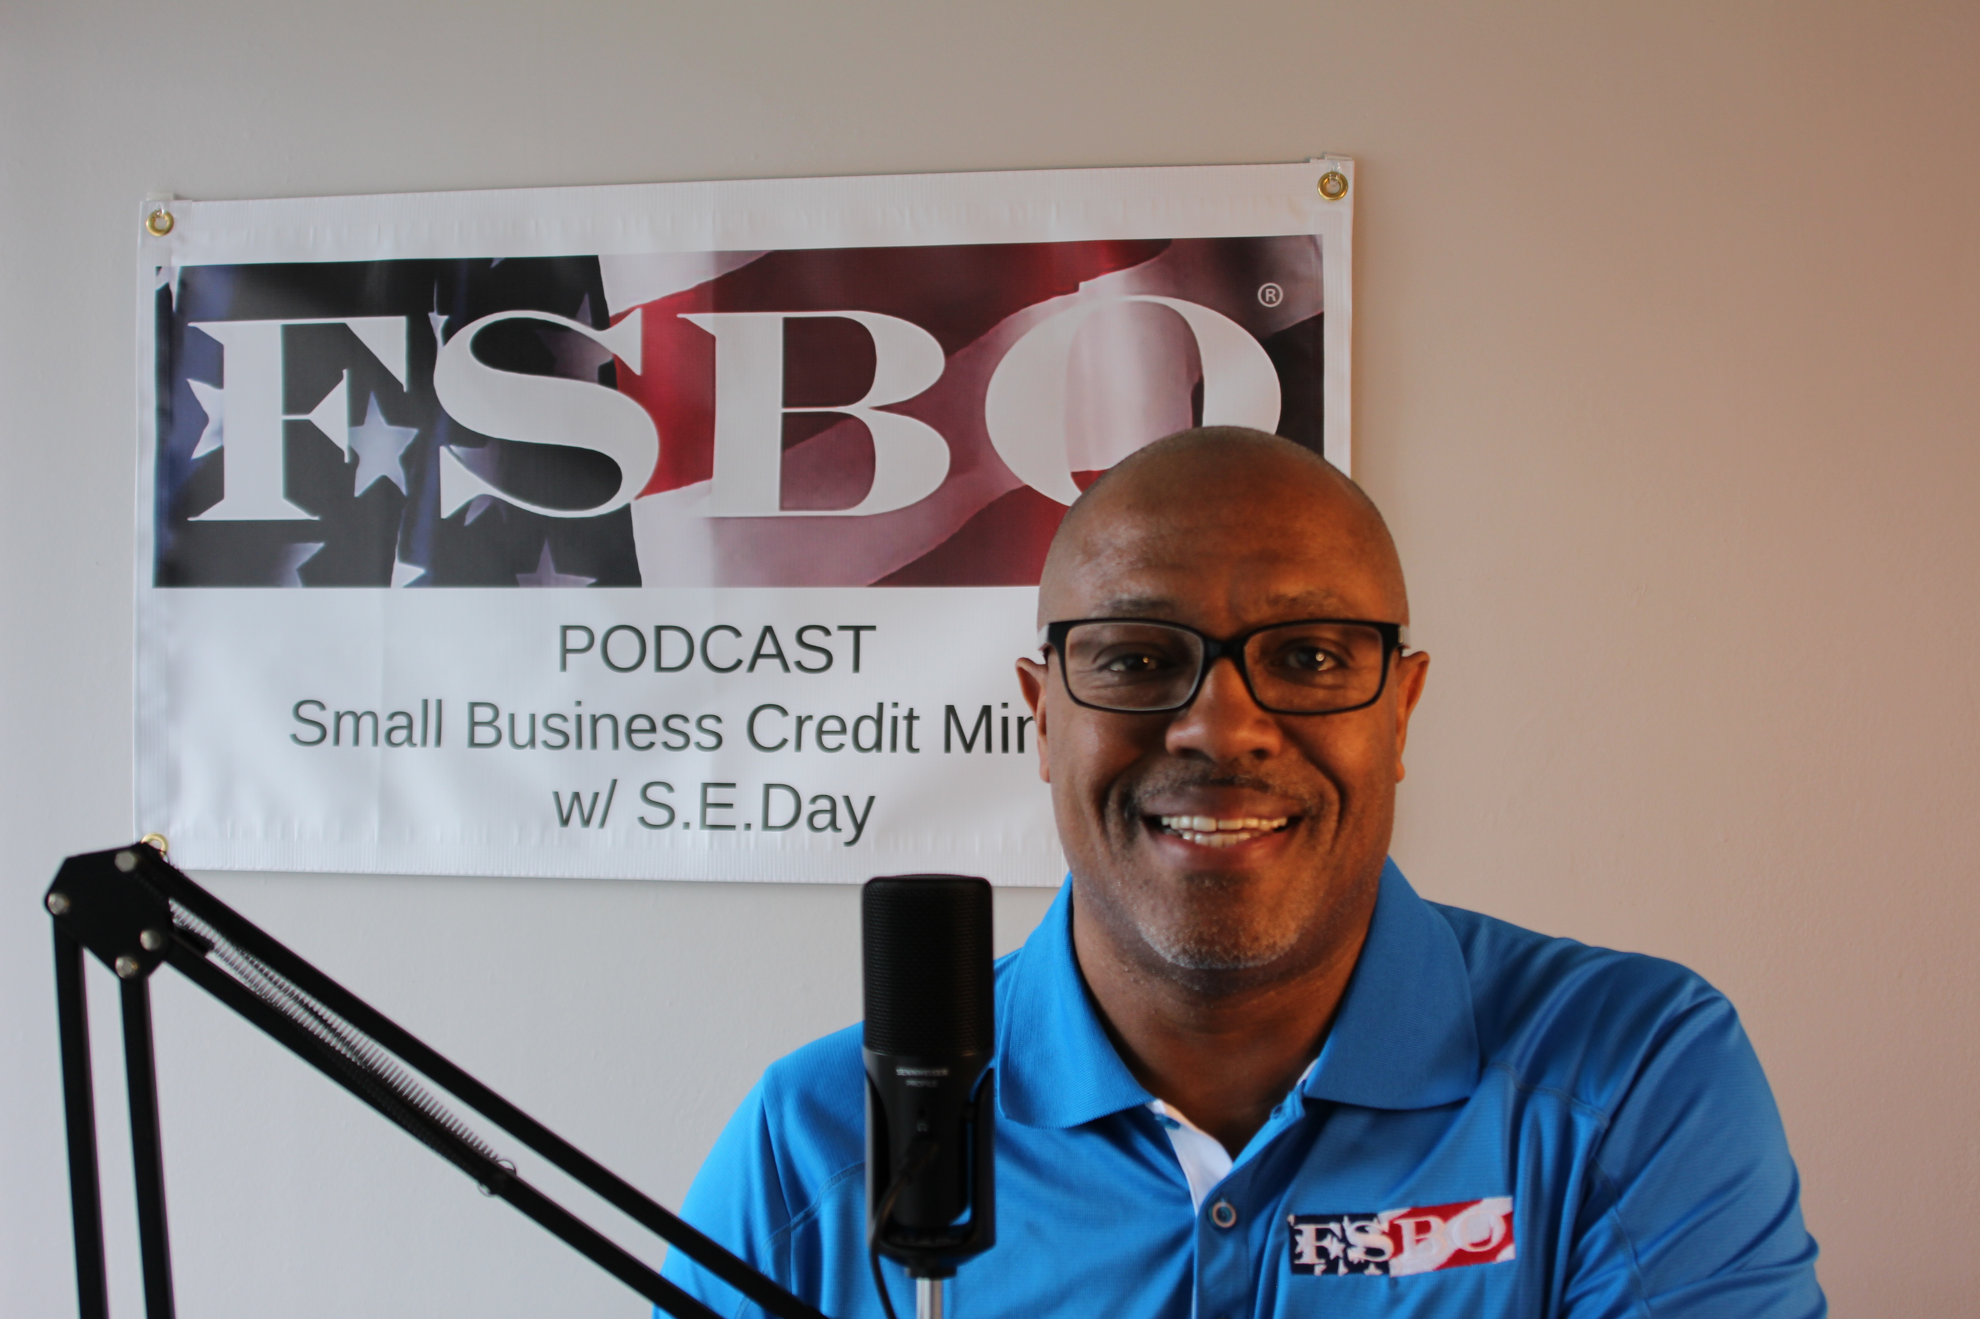
property activations - interview station
The Interview Station Session is an opportunity for attendees to provide instant feedback from scripted questions about their experiences engaging with sponsors and the content presented at the Boot Camp though the SBCM podcast. This ‘on-site’ interview session provides the sponsor with a platform to share their expertise, showcase their products or services, and answer real-time questions from participants.
Sponsors are promoted as trusted partners, offering credit tools that align with the challenges small business owners face. In building credit.
Attendees will enjoy an opportunity to promote their business while promoting the benefit of the sponsors participation. During the Interview, the audience can:
Instant feedback
Promote sponsor participation
Build brand awareness through the testimony of actual small business owners
This experience positions the sponsor as a helpful partner rather than just a vendor — deepening trust and increasing the likelihood of post-event engagement.
Sponsors receive integrated visibility before, during, and after the AMA session:
Pre-Event Branding
Live Event Branding
Digital Engagement
Post-Event Follow-Up and promotions via website and podcast.
Sponsors can measure the activation’s ROI using both qualitative and quantitative metrics:
Engagement Metrics
Reach & Visibility
Lead Generation
Brand Sentiment
Conversions

Slide 23
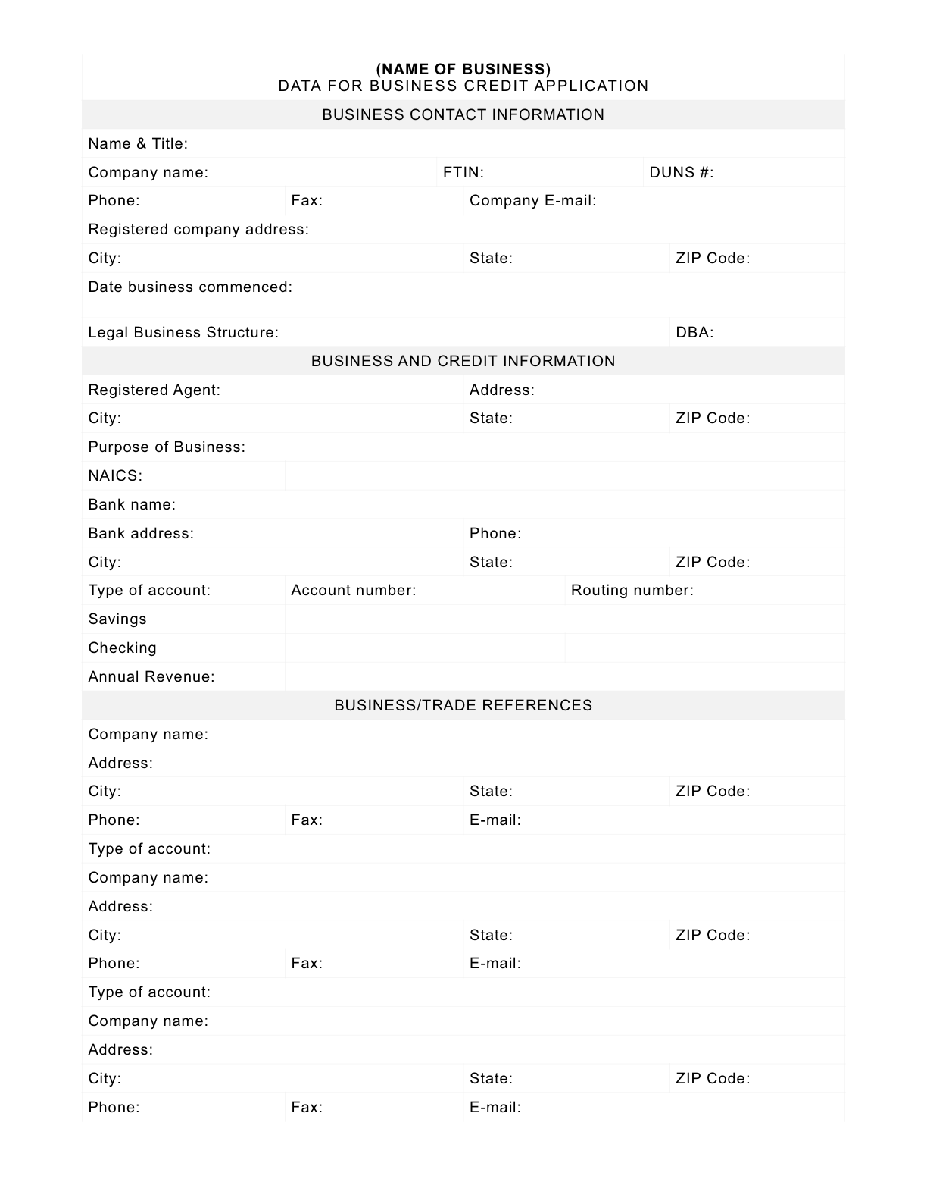
All of our sponsors receive
All of our sponsors receive the following benefits as a starting point
  31+ Business Data Points on each Attendee via Business Data Sheet
  Immediate access to Attendees
  Opportunity to provide flyers/company information
  Logo Placement on Event Advertisements
  Social media promotions
  Media exposure

Slide 24
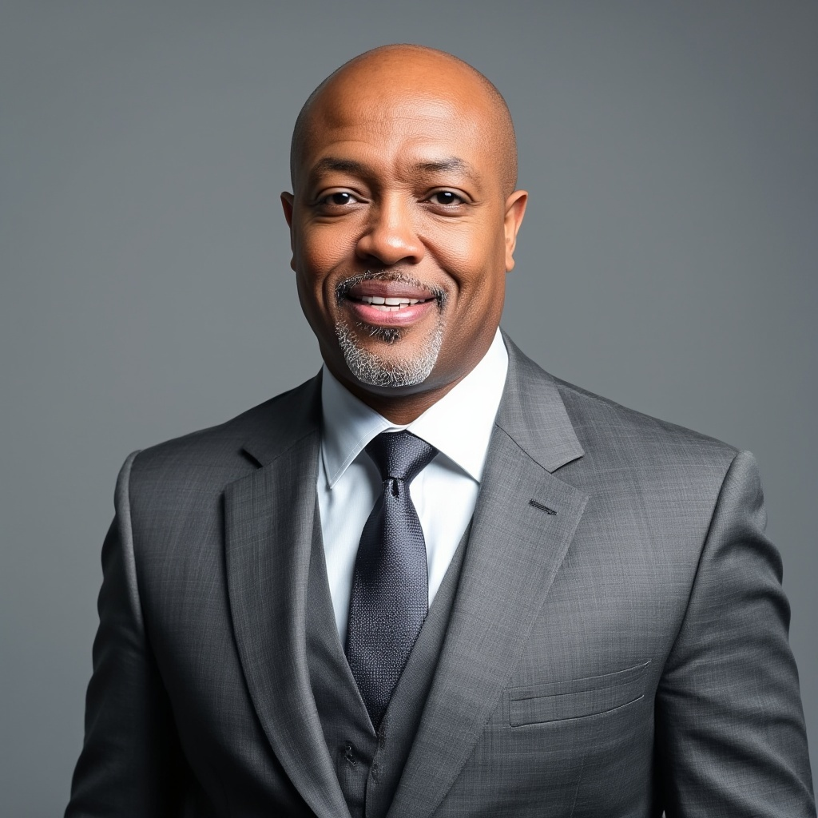
Let’s talk about opportunities we can create for you
Sandy (S.E.) Day
EVP of Corporate Partnerships
Cell: 571-532-1761
seday@fsbonly.com
Let’s start a conversation and increase your yield!

